Slide 1


Robotic Process Automation using UiPath
Topic 6- Email Automation in Studio
HITESH KUMAR SHARMA
Technical Instructor & Consultant

Slide 2

Introduction to RPA
StudioX Citizen Developer Journey and Working with StudioX
Activity Recording, UI Automation in StudioX
Decisions, Iterations, and Scenarios in StudioX
File, Folder Automation in StudioX: Microsoft Excel Automation
Email Automation in StudioX
Handle Errors in StudioX
COURSE OBJECTIVES

Slide 3
6. EMAIL & SAP AUTOMATION IN STUDIOX
Microsoft Outlook Reading Email Automation
Microsoft Outlook Writing and Sending Email Automation
Downloading Attachment from Email Automation (Outlook)

Slide 4
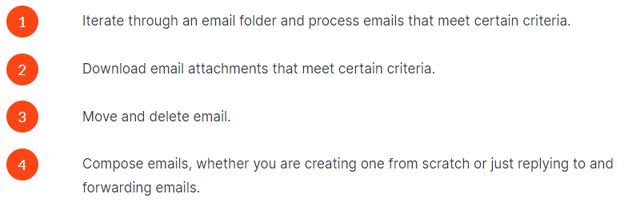
EMAIL AUTOMATION
Firstly, let us ask you one question: have you ever set any rules in Outlook or Gmail to move emails that meet certain criteria into a dedicated folder?
When you use email for business, you likely spend a great deal of time creating, sending and reading emails, working with specific email groups, and downloading important attachments. These are tasks you can easily automate in StudioX.

Slide 5
EMAIL AUTOMATION
Using UiPath StudioX, you can automate operations on emails through a variety of dedicated activities.
Listed under the Mail category are all the email activities. We'll show you how to use a couple of activities in the following demo.
There are three resource activities that allow you to be flexible with the email client used: Use Desktop Outlook App, Use Outlook 365 and Use Gmail.
If your task requires repeating the same set of actions for each email in a folder, you'll find a dedicated iteration activity: For Each Email.
.

Slide 6
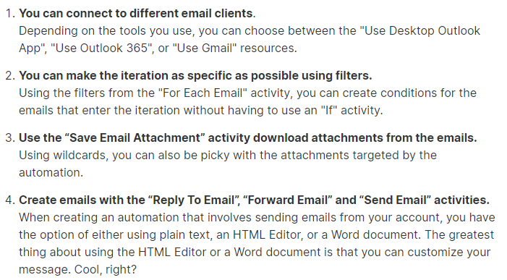
EMAIL AUTOMATION (Hands-on)
In the following Demo, you'll help Jude, a diligent financial clerk. Their task is to make sure all emails received from a specific address are processed the same day. And there's a catch! Only emails that meet a certain attachment criterion should be processed.

Slide 7
TOPIC 6
END
THANK YOU

